Slide 1

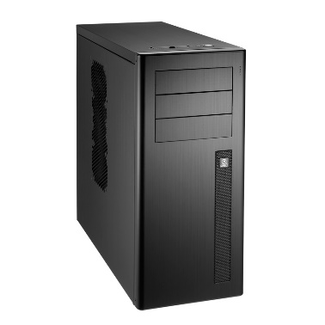
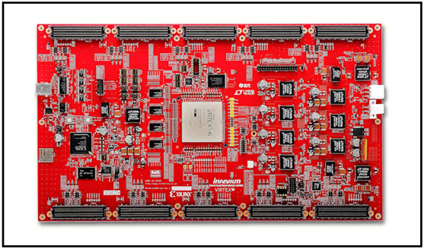
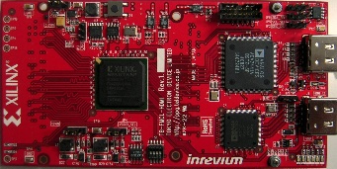
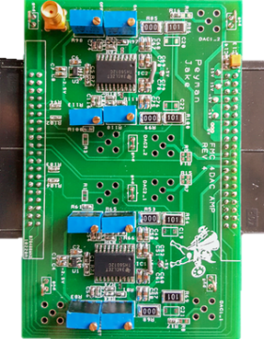
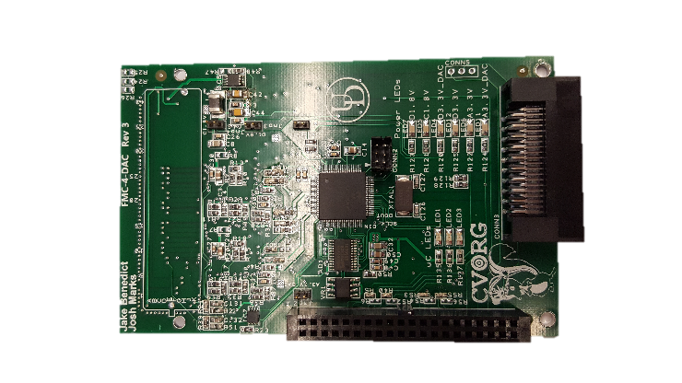
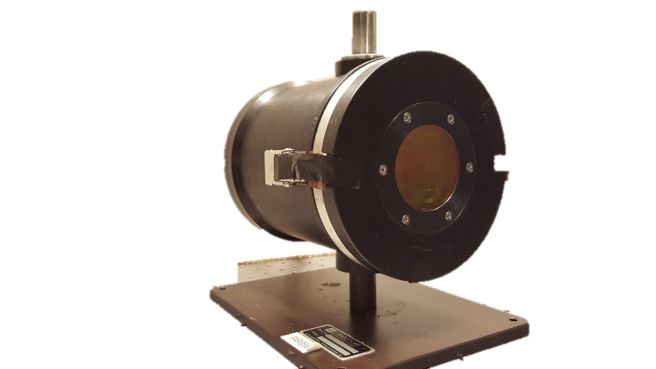
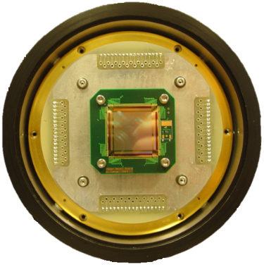
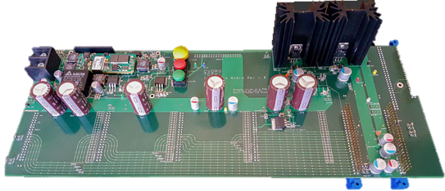
Monitor Output
Projector Control & Configuration System
FPGA Main Board with 10 FMC Slots
Close Support Electronics
8x DAC Cards
8x Amp Cards
Scene Generator
System
NUC
System
HDMI INPUT 1
HDMI INPUT 2
Dewar – RIIC
Hybrid Array
2x Interface Board

Slide 2
Current Hardware Architecture of TCSA System
Monitor Output
Projector Control & Configuration System
FPGA Main Board with 10 FMC Slots
8x DAC Cards
8x Amp Cards
Scene Generator
System
HDMI INPUT 1
HDMI INPUT 2
Dewar – TCSA RIIC
TCSA Hybrid Array
Interface Board

Slide 3
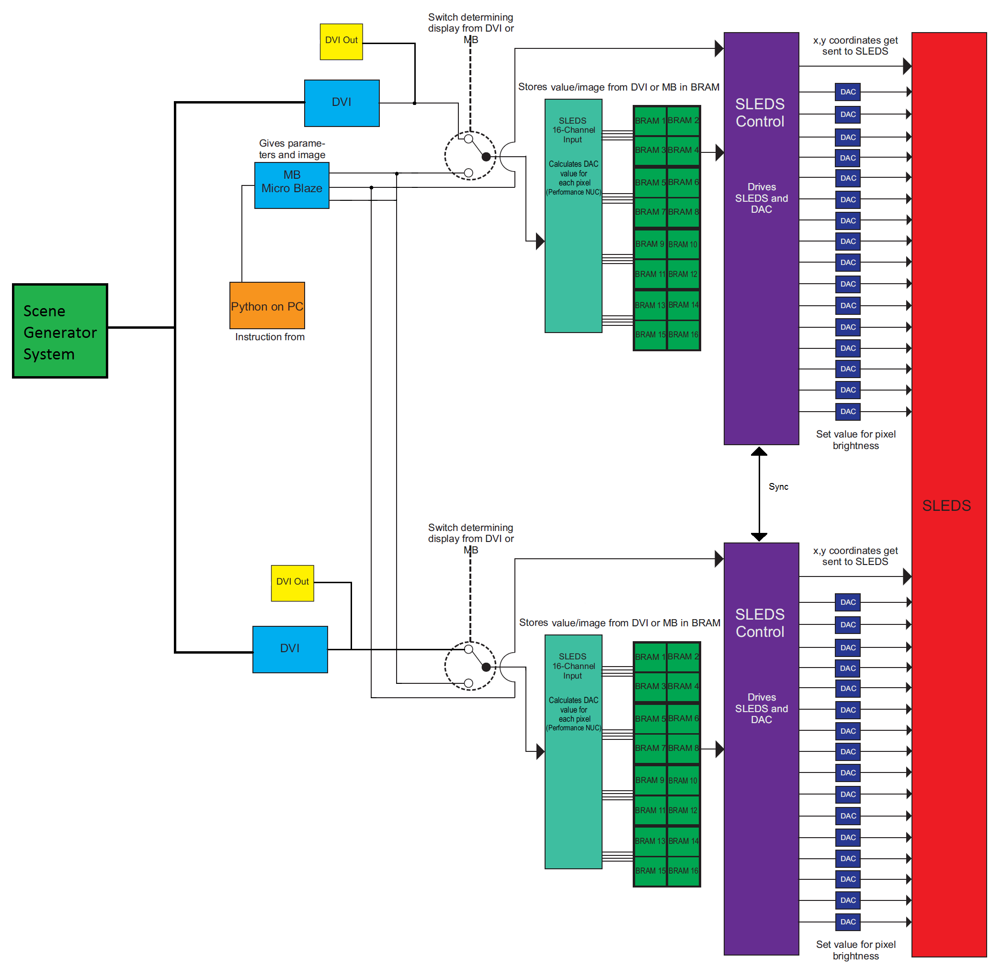
Current Software Architecture of TCSA System

Slide 4
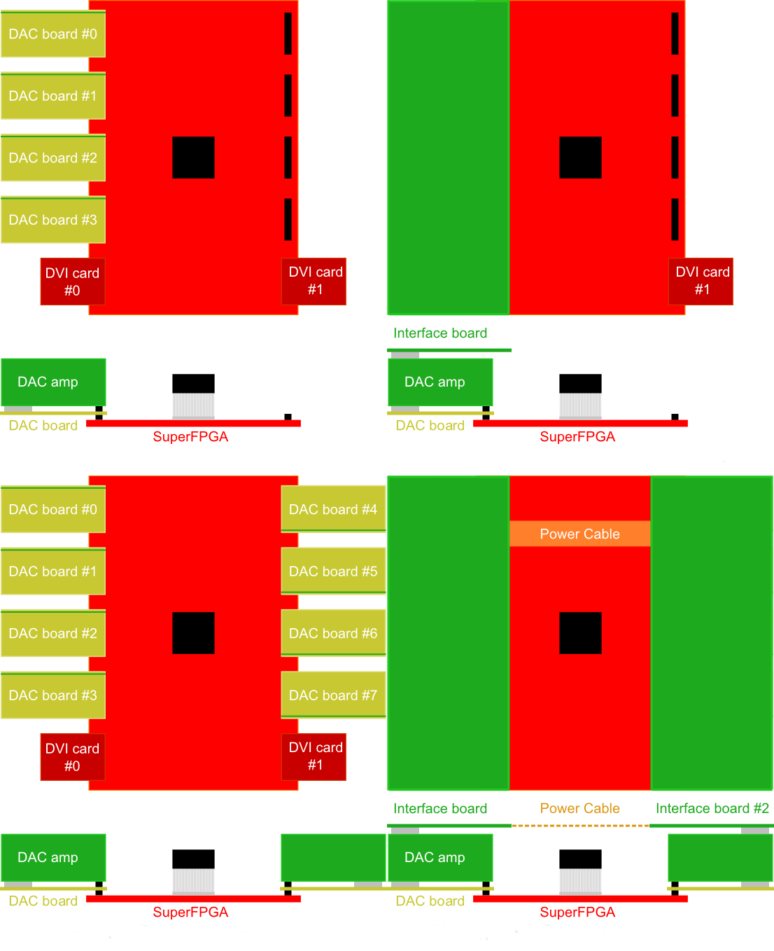
Examples
Scalable Firmware with Hardware
We are able to scale the TCSA Firmware depending on the amounts of DAC cards connected.
DAC card options: 1,2,4,8

Slide 5
Projector Control & Configuration System
Video Architecture of TCSA System
FPGA Main Board with 10 FMC Slots
BRAM 1
Output from FPGA
Scene Generator
System
512
HDMI INPUT 1
24 bit 512 x 256
Address
Data (1/12/11)
WEA
256
Clk
HDMI INPUT 2
24 bit 512 x 256
BRAM 2
Address
Data (1/12/11)
256
WEA
Clk

Slide 6
Projector Control & Configuration System
Video Architecture of TCSA System
FPGA Main Board with 10 FMC Slots
Scene Generator
System
HDMI INPUT 1
24 bit 512 x 256
Address
Data (1/12/11)
WEA
Clk
HDMI INPUT 2
24 bit 512 x 256
Address
Data (1/12/11)
WEA
Clk

Slide 7
HDMI INPUT 1
24 bit 512 x 256
BRAM 1
Data Red 12 bits
Strong/Weak 1 bit
Address, CLK, WEA
Data Blue 11 bits
BRAM 2
BRAM 3
HDMI INPUT 2
24 bit 512 x 256
Data Red 12 bits
Strong/Weak 1 bit
Address, CLK, WEA
Data Blue 11 bits
BRAM 4

